Slide 1
TCP/IP Client Server Communication
Lab Program - 3

Slide 2
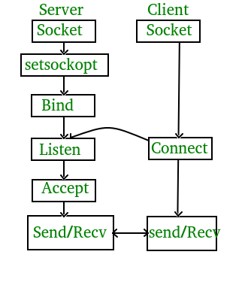
TCP/IP Client Server Communication
TCP Server
Create() - Create TCP socket.
Bind() - Bind the socket to server address.
Listen() - put the server socket in a passive mode, where it waits for the client to approach the server to make a connection
Accept() - At this point, connection is established between client and server, and they are ready to transfer data.
Go back to Step 3.
TCP Client
Create TCP socket.
Connect newly created client socket to server.

Slide 3
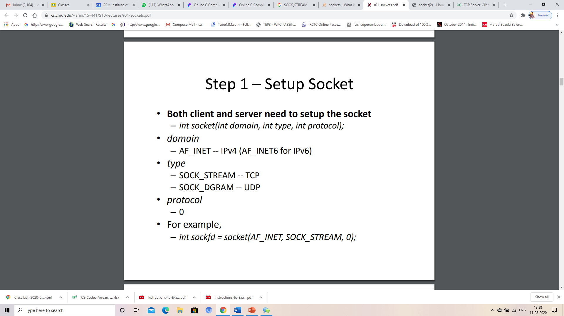
Setup Socket
Sock_stream - Provides sequenced, reliable, two-way, connection- based byte streams.
Scok_Dgram - Supports datagrams (connectionless, unreliable messages of a fixed maximum length).

Slide 4
Socket address structure
servaddr.sin_family=AF_INET
AF_INET is an address family that is used to designate the type of addresses that your socket can communicate with (in this case, Internet Protocol v4 addresses).
servaddr.sin_addr.s_addr=htonl(INADDR_ANY)
INADDR_ANY is used when you don't need to bind a socket to a specific IP. When you use this value as the address when calling bind() , the socket accepts connections to all the IPs of the machine.
The htonl() function converts the unsigned integer hostlong from host byte order to network byte order.
servaddr.sin_port=htons(1999)
The htons() function converts the unsigned short integer hostshort from host byte order to network byte order.

Slide 5
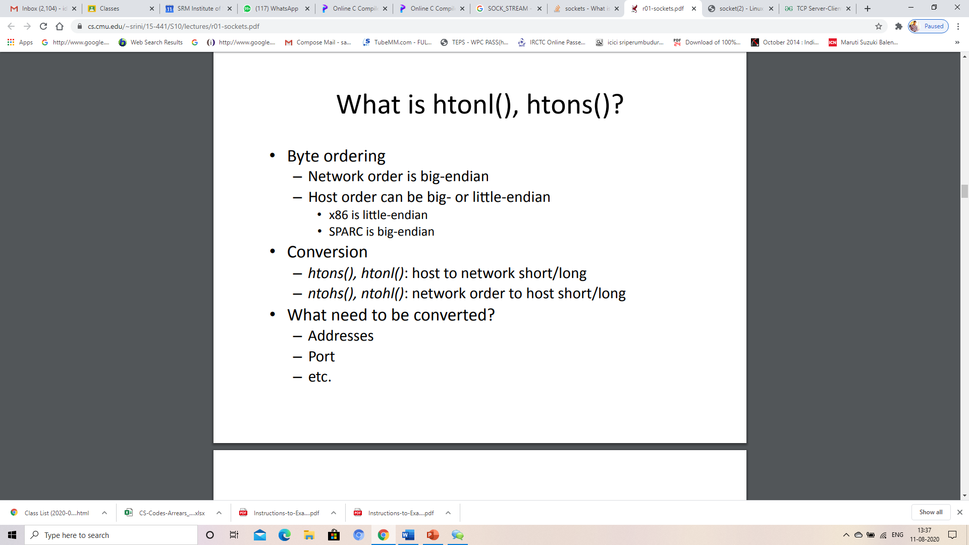
What is htonl(),htons()?

Slide 6
The sockfd argument is a file descriptor that refers to a socket of type SOCK_STREAM or SOCK_SEQPACKET.
backlog – number of pending connections to queue

Slide 7
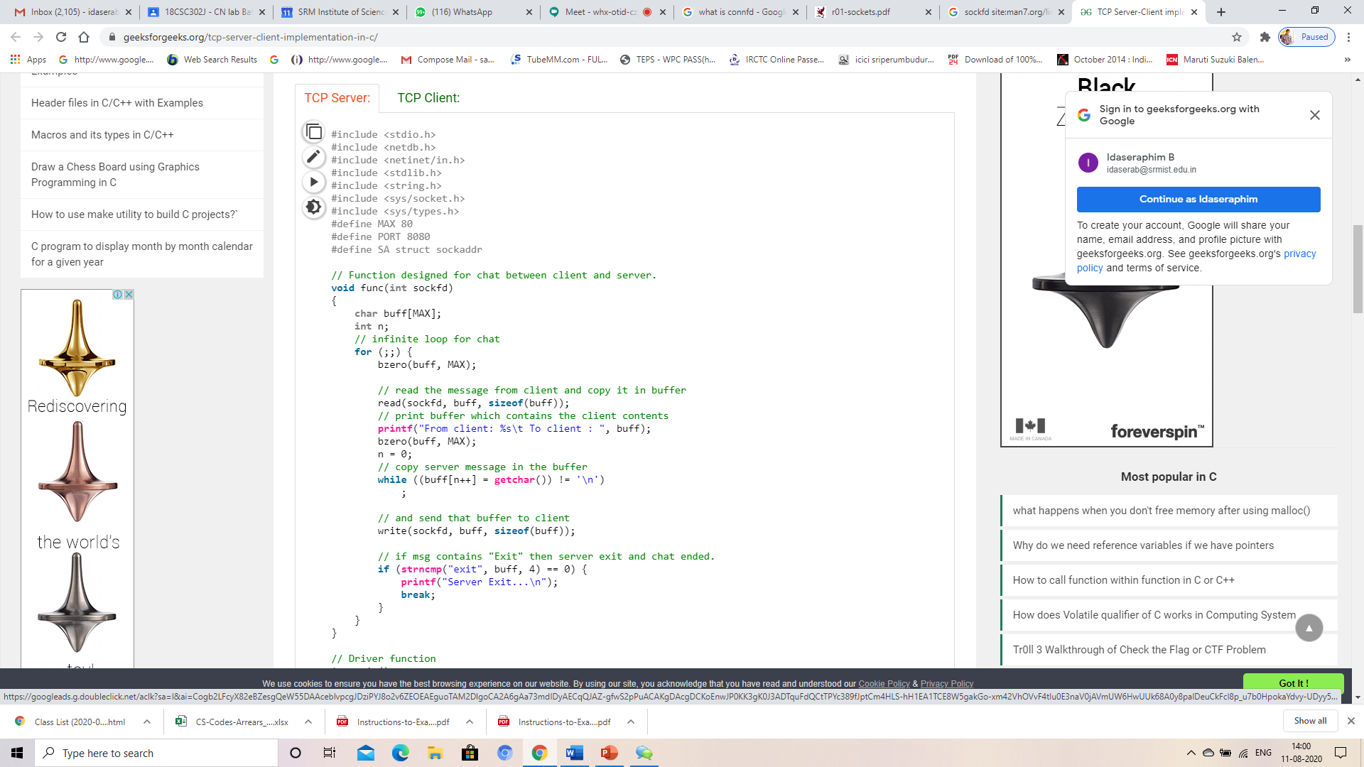
Server Side
The bzero function places nbyte null bytes in the string s. This function is used to set all the socket structures with null values.

Slide 8
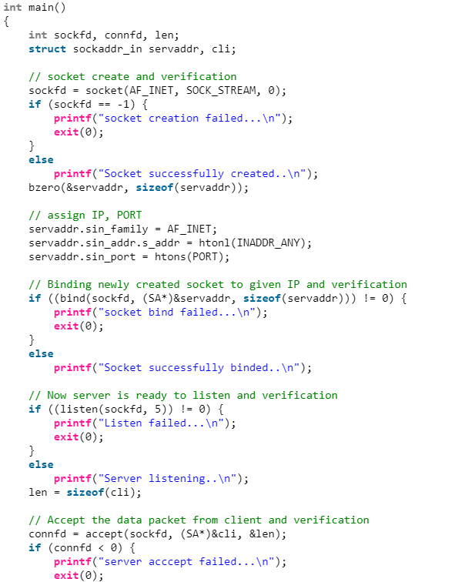
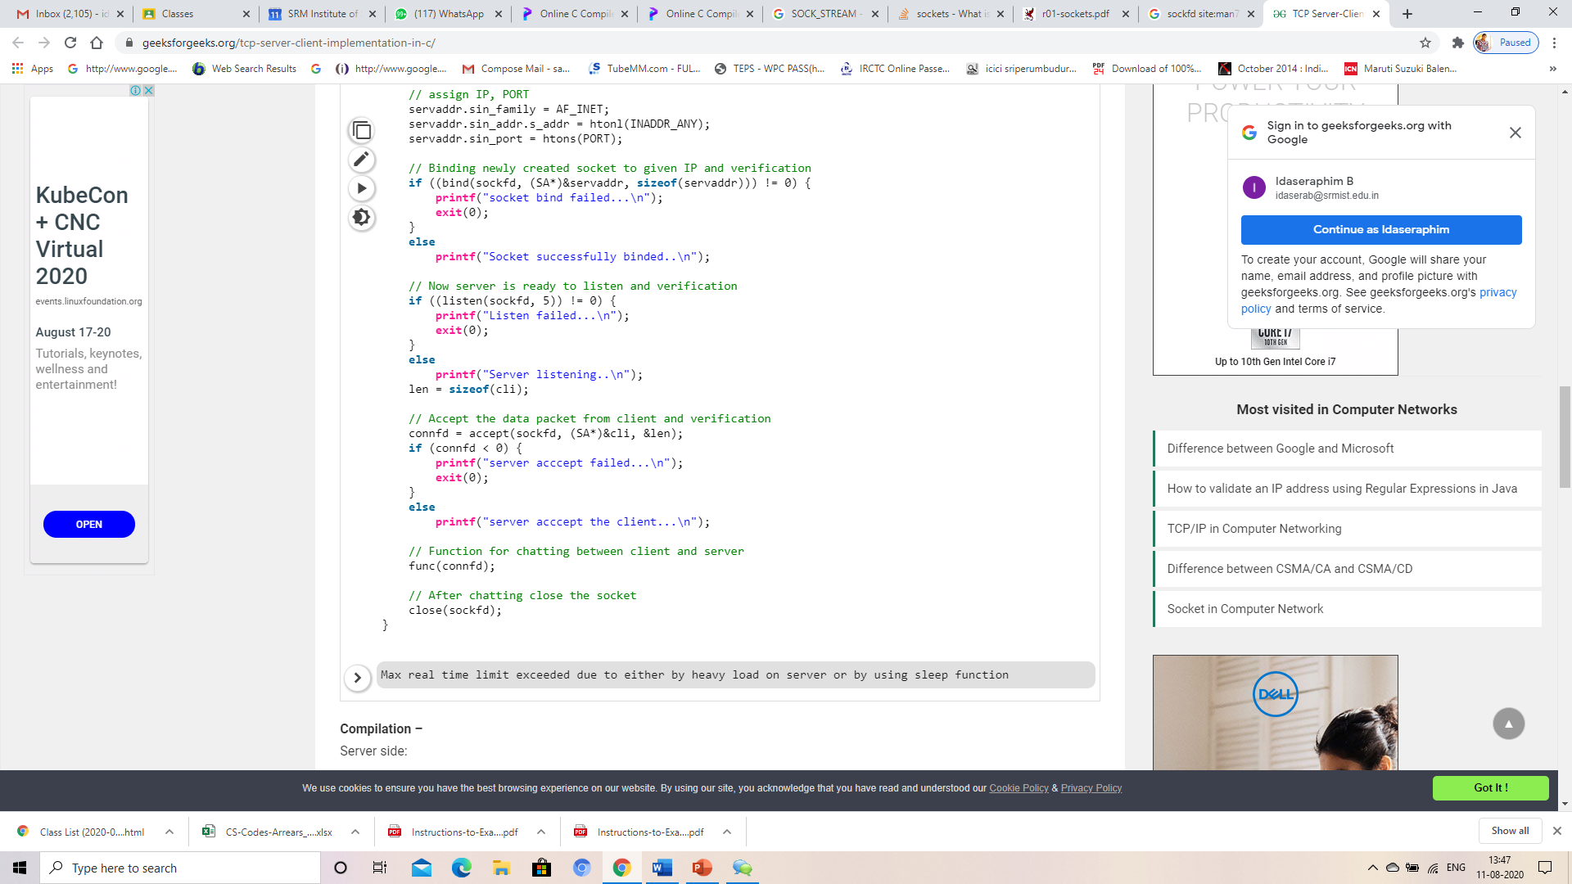

Slide 9
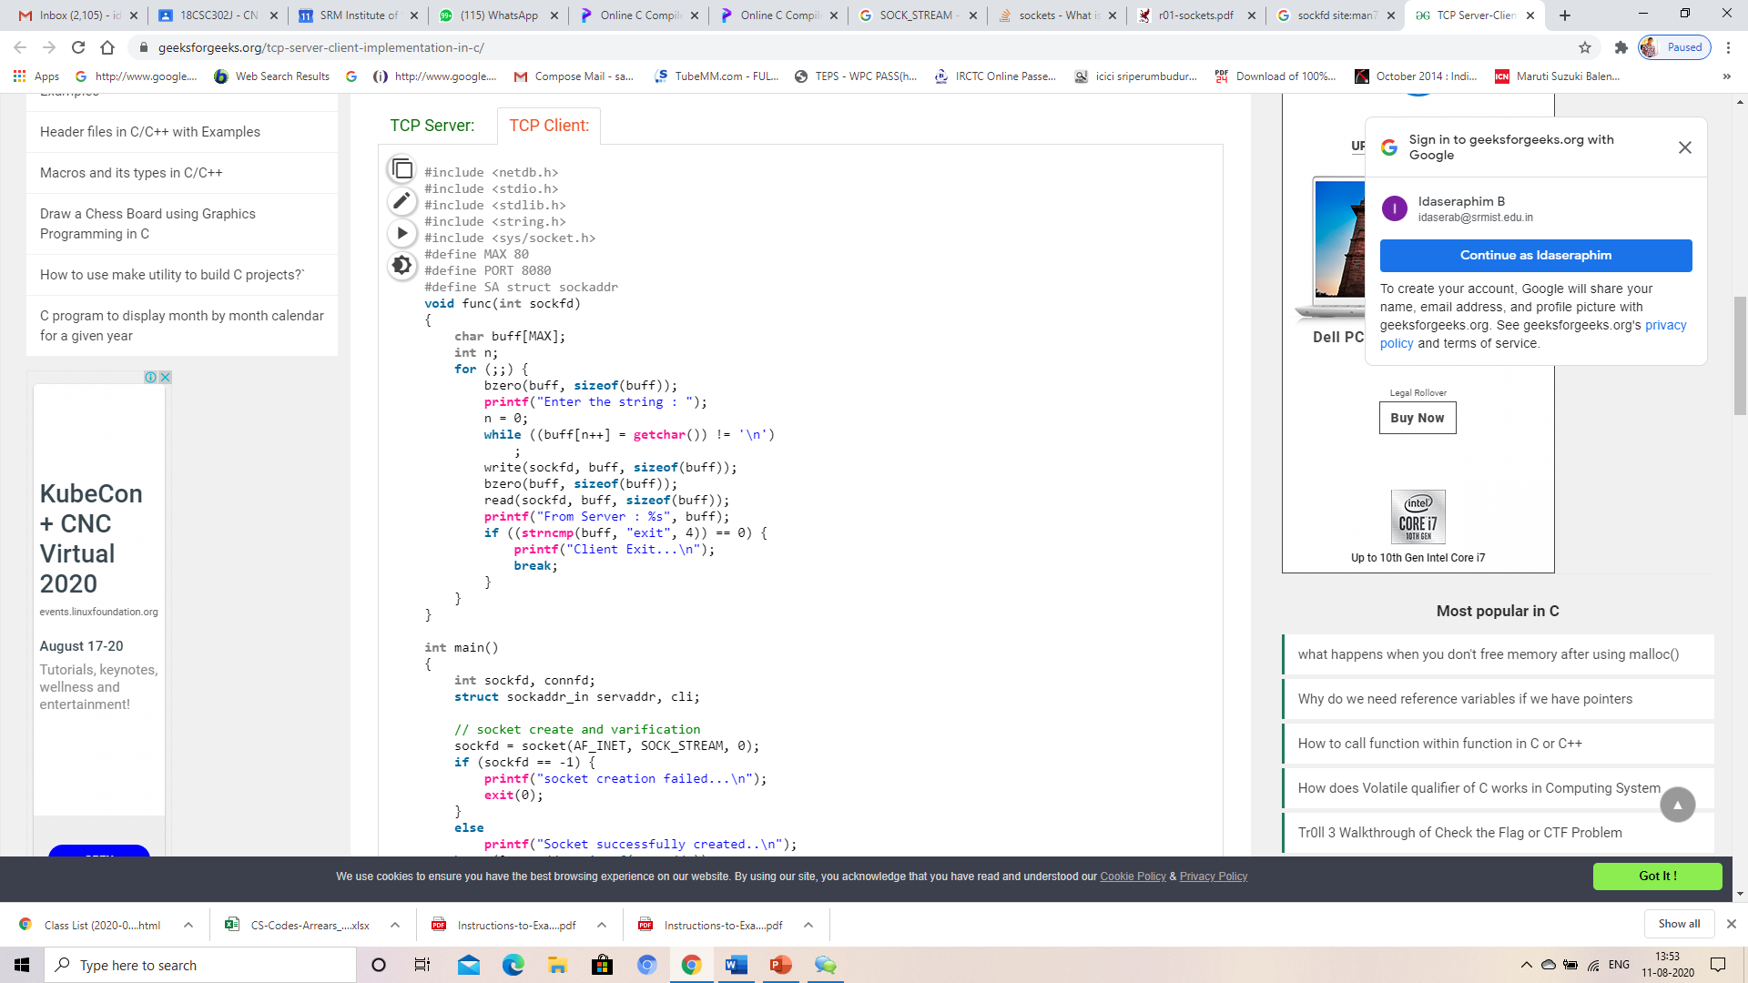
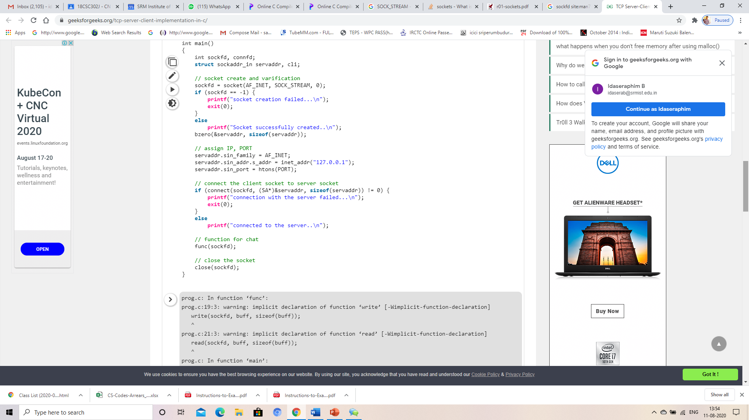
Client Side

Slide 10
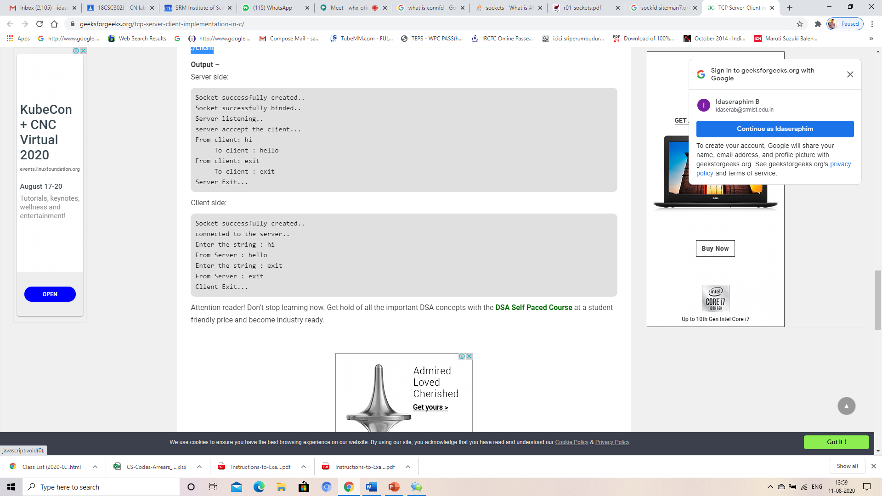
Compilation –
Server side: gcc server.c -o server ./server
Client side: gcc client.c -o client ./client

